Slide 1
POs
Sr.No. | Outcome | Heading | Description
 | 1 | PO1 | Engineering Knowledge | Apply the knowledge of mathematics, science, engineering fundamentals, and an engineering specialization to the solution of complex engineering problems.
 | 2 | PO2 | Problem Analysis | Identify, formulate, review research literature, and analyse complex engineeringproblems reaching substantiated conclusions using first principles of mathematics, natural sciences andengineering sciences.
 | 3 | PO3 | Design/Development of Solutions | Design solutions for complex engineering problems and designsystem components or processes that meet the specified needs with appropriate consideration for thepublic health and safety, and the cultural, societal, and environmental considerations.
 | 4 | PO4 | Conduct investigations of complex problems | Use research-based knowledge and research methods including design of experiments, analysis and interpretation of data, and synthesis of the information to provide valid conclusions.
 | 5 | PO5 | Modern Tool Usage | Create, select, and apply appropriate techniques, resources, and modernengineering and IT tools including prediction and modelling to complex engineering activities with anunderstanding of the limitations.
 | 6 | PO6 | The Engineer and Society | Apply reasoning informed by the contextual knowledge to assess societal,health, safety, legal and cultural issues and the consequent responsibilities relevant to the professionalengineering practice.
 | 7 | PO7 | Environment and Sustainability | Understand the impact of the professional engineering solutions insocietal and environmental contexts, and demonstrate the knowledge of, and need for sustainabledevelopment
 | 8 | PO8 | Ethics | Apply ethical principles and commit to professional ethics and responsibilities and norms of theengineering practice.
 | 9 | PO9 | Individual and Team Work | Function effectively as an individual, and as a member or leader in diverseteams, and in multidisciplinary settings
 | 10 | PO10 | Communication | Communicate effectively on complex engineering activities with the engineeringcommunity and with society at large, such as, being able to comprehend and write effective reports anddesign documentation, make effective presentations, and give and receive clear instructions.
 | 11 | PO11 | Project Management and Finance | Demonstrate knowledge and understanding of the engineering andmanagement principles and apply these to one’s own work, as a member and leader in a team, to manageprojects and in multidisciplinary environments.
 | 12 | PO12 | Life-long Learning | Recognize the need for, and have the preparation and ability to engage in independent and lifelong learning in the broadest context of technological change.

Slide 2

CSE101 Computer Programming
Lecture #0

Slide 3
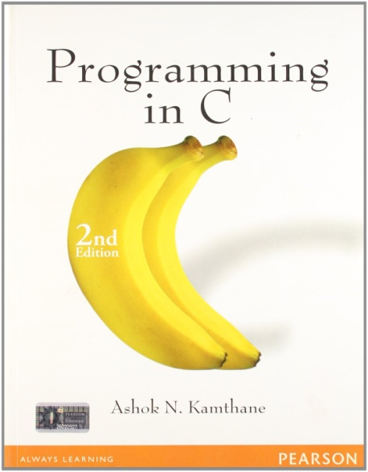
Course Details
Text Book
“PROGRAMMING IN C”
by
ASHOK N. KAMTHANE
PEARSON, 2nd Edition
L | T | P
2 | 0 | 2

Slide 4
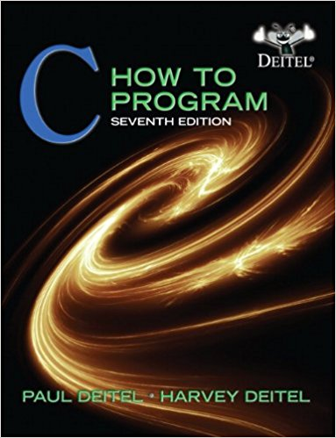
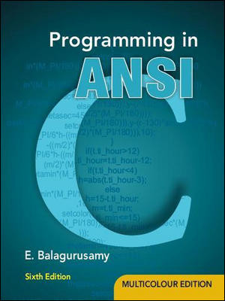
Reference Books
“C HOW TO PROGRAM” by
PAUL DEITEL AND
HARVEY DEITEL
PHI(Prentice Hall India)
“PROGRAMMING IN ANSI C”
By E. BALAGURUSAMY
McGraw Hill Education

Slide 5


Syllabus and Instruction Plan(IP)

Slide 6
Course Assessment Model
Marks break up
Attendance 5
Academic Task 25
MTE 20
ETE 50
Total 100

Slide 7
Academic Task
Component Week
CA1 – MCQ on paper 5th
Code based test 9th
Project in group 3- 11th
Sequential group-4,5 marks pre-submission, 15 marks for module,5 marks final , 5 mark Viva
Total Weeks: 14( 7 Before MTE and 7 After MTE)

Slide 8

Mode of Conduct
BYOD(Bring your own device)
Note: Laptops are mandatory for program implementation.

Slide 9





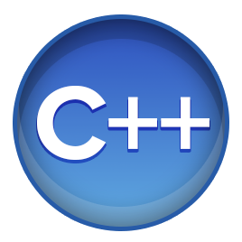

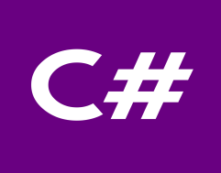

WHY C???????????????
If we have number of powerful programming languages available with us then why c??????

Slide 10


The hitch...............
Some burning questions in mind......
C is a very old language. Why are we still studying this language??????
Now, we have very powerful languages with us then, why c??
There is no scope of this language in industry

Slide 11





Lets take you close to the reality
All of us use Computers or Laptops for different purposes.
Could you tell me which system software is most required to get our system in working mode??????

Slide 12
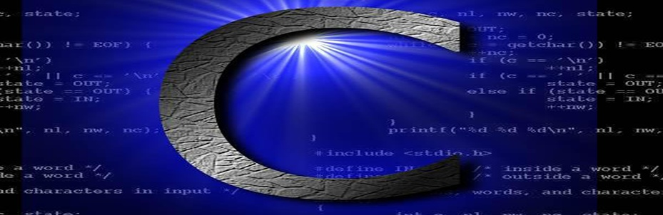
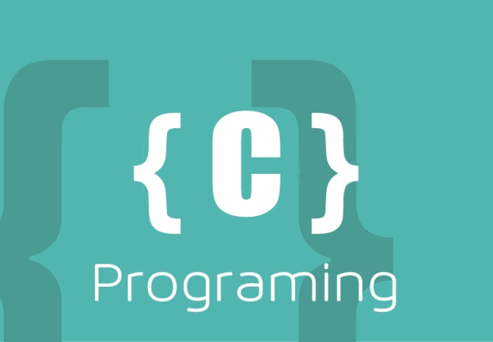

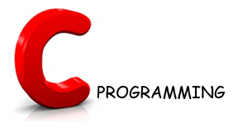
Let’s Explore more
Could you tell me which programming language is used in writing all these operating system??????
Latest version of Microsoft Windows i.e. Windows10 is still being written in C Language

Slide 13
Contd.....
Device drivers are also written in C language.
All these modern programming languages are influenced by C language
Compilers for Python and PHP language are also written in C language

Slide 14
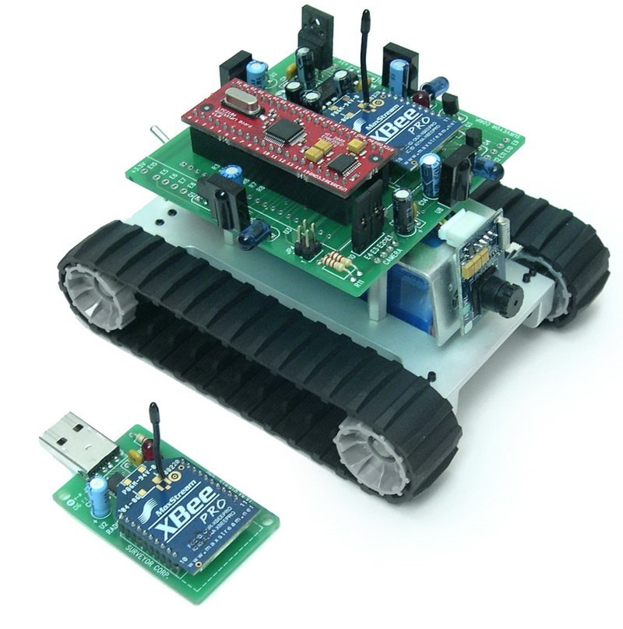
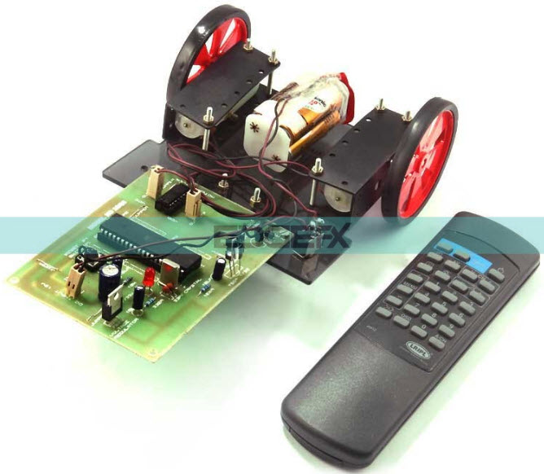
Contd.....
Embedded systems are also developed with the help of C language

Slide 15

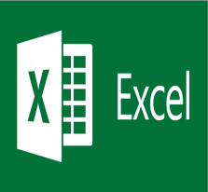




Contd.....
Git
 | Microsoft Excel
Oracle Database
 | MySql
Linux
 | Unix
Android
 | Google

Slide 16











MNCs
Top rated Companies which has a dearth of C programmers

Slide 17


Here are the Answers of Questions
C is very a old language still, why do we study C language??
Now, we have very powerful languages
with us then why c??
There is no scope of this language in industry
Basic Pillar
Scope for Experts always Exists

Slide 18
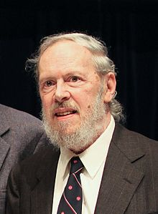
History of C
Guys Can you make a sentence with the word ‘Necessity’
“Necessity is the mother of invention”
Dennis Ritchie and Ken Thompson were working on developing a new operating system i.e UNIX
But the programming language they
were using was not providing them
the portability feature
So Dennis Ritchie developed new
language i.e C

Slide 19
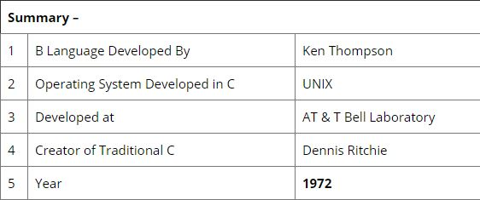
History continued...

Slide 20
Why “C” name was given???
Many of C’s principles and ideas were derived from the earlier language B. (Ken Thompson was the developer of B Language.)
BCPL and CPL are the earlier ancestors of B Language
CPL is Combined Programming Language. In 1967, BCPL Language ( Basic CPL ) was created as a scaled down version of CPL
As many of the features were derived from “B” Language thats why it was named as “C”.
After 7-8 years C++ came into existence which was first example of object oriented programming .

Slide 21
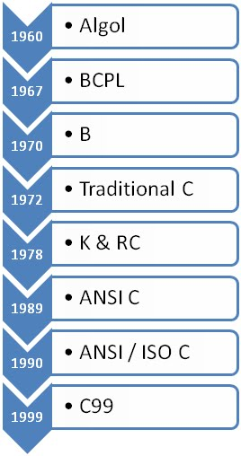
Evolution of C...

Slide 22
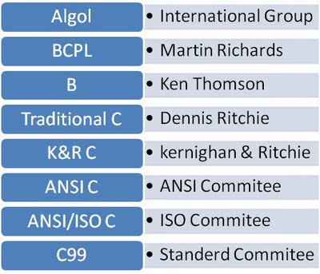
Language Developers

Slide 23
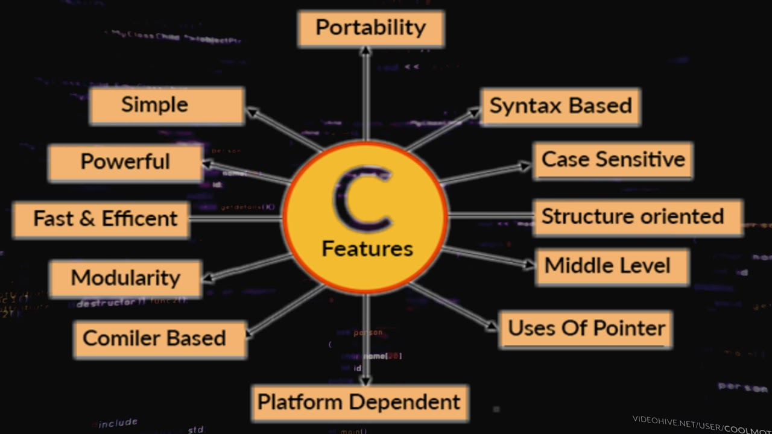
Features of C Language
Notes:
https://www.sitesbay.com/cprogramming/c-features

Slide 24
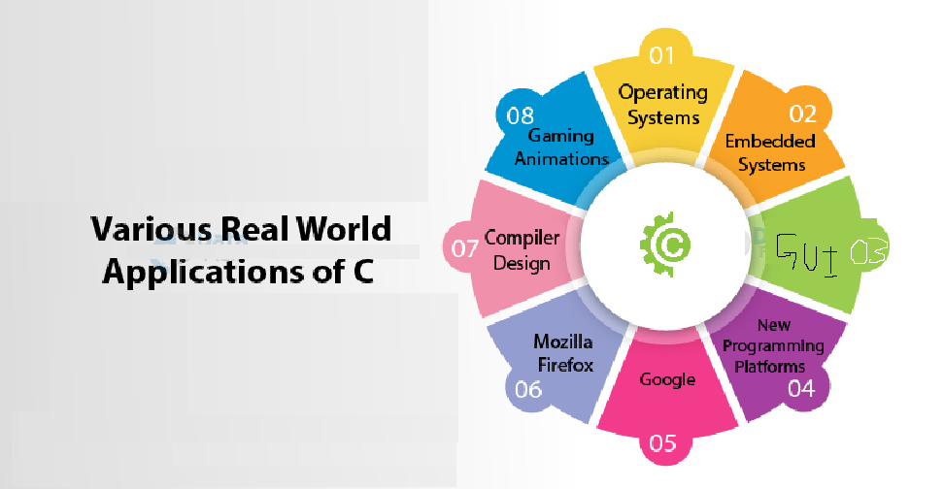
Applications of C
Notes:
https://data-flair.training/blogs/applications-of-c/

Slide 25
Course Contents
Before MTE
Data Types & Operators Control Structures
User Defined Functions Storage Classes
After MTE
Arrays and Strings Pointers
Dynamic Memory Allocation File I/O Derived Data Types- Structures and Union

Slide 26
Who is father of C Language?
A. Bjarne Stroustrup
B. James A. Gosling
C. Dennis Ritchie
D. Dr. E.F. Codd
Notes:
Ans c

Slide 27
Which of the following statement is correct about the C language?
The C language is a binary language with some extra features.
The C language is a high-level language with some low features.
The C language is a mid-level language with some high features.
The C language is a low-level language.
Notes:
Ans 3

Slide 28
C Language developed at _________?
A. AT & T's Bell Laboratories of USA in 1972
B. AT & T's Bell Laboratories of USA in 1970
C. Sun Microsystems in 1973
D. Cambridge University in 1972
Notes:
Ans : A

Slide 29


Basics and introduction to C
Program Development in C

